Slide 1
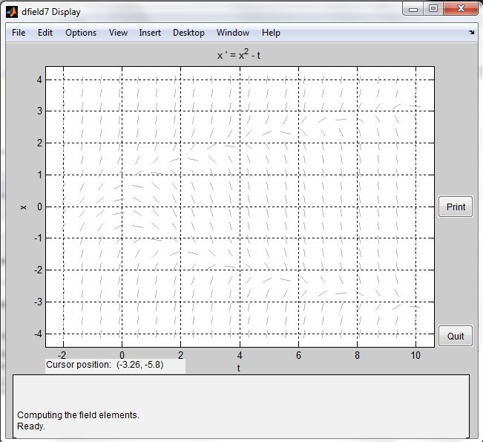
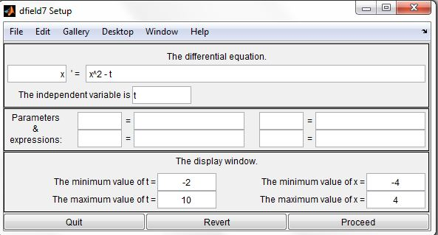
ECE 101 Matlab Assignment #8
Ryan M Fenn
Due December 7, 2011

